Slide 1
Online Learning Trends: Udemy vs Coursera (2010 - 2025)
Exploring how online education topics evolve and how Google Trends interest reflects real platform growth

Slide 2
Overview & Research Focus
Goal:
Understand how learning platforms reflect public interest trends
Research Questions:
What are the most popular and fastest-growing topics?
How do Coursera and Udemy differ in focus?
Does Google search activity predict course topic growth?
Scope:
Udemy (2010 - 2017)
Coursera (2025 snapshot)
Google Trends (2010 - 2025)

Slide 3
Data Sources
Source | Type | Method | Key Info
Udemy Online Education Dataset | CSV (Kaggle) | Local Import | 3,678 courses, 2011 - 2025
Coursera Courses Dataset | CSV (Kaggle) | Local Import | 3,404 courses, 2025 snapshot
Google Trends | API (Pytrends) | Live fetch | Machine learning interest, 2010 - 2025

Slide 4
Pipeline
Load & clean data (fp_io.py, fp_topics.py)
Extract year, normalize topics, filter valid years
Aggregate & compute shares (Topic_share_by_year)
Fraction of courses per topic, per year, per platform
Visualize trends
Matplotlib
Pull Google Trends data
(fetch_trend_yearly() from fp_trends.py)
Regression:
Check if Google interest (t-1) predicts Udemy share change (t)

Slide 5
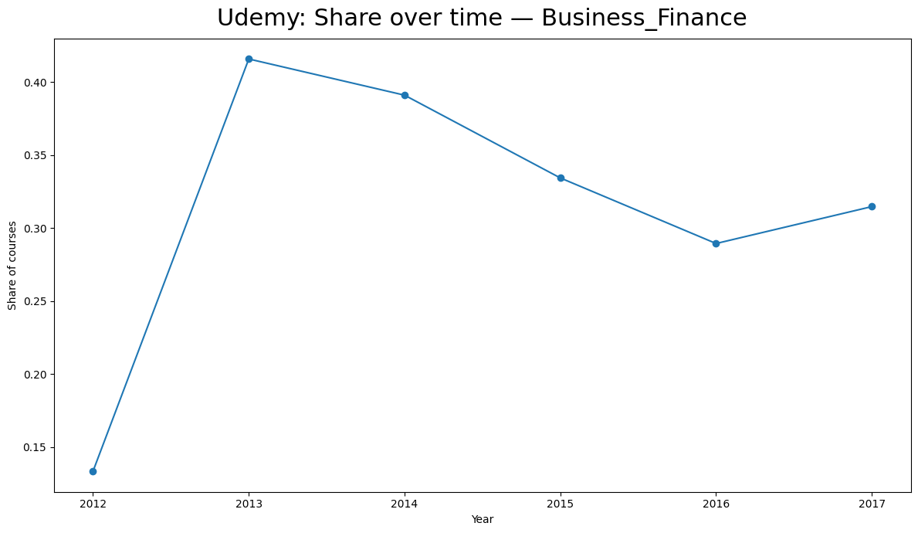
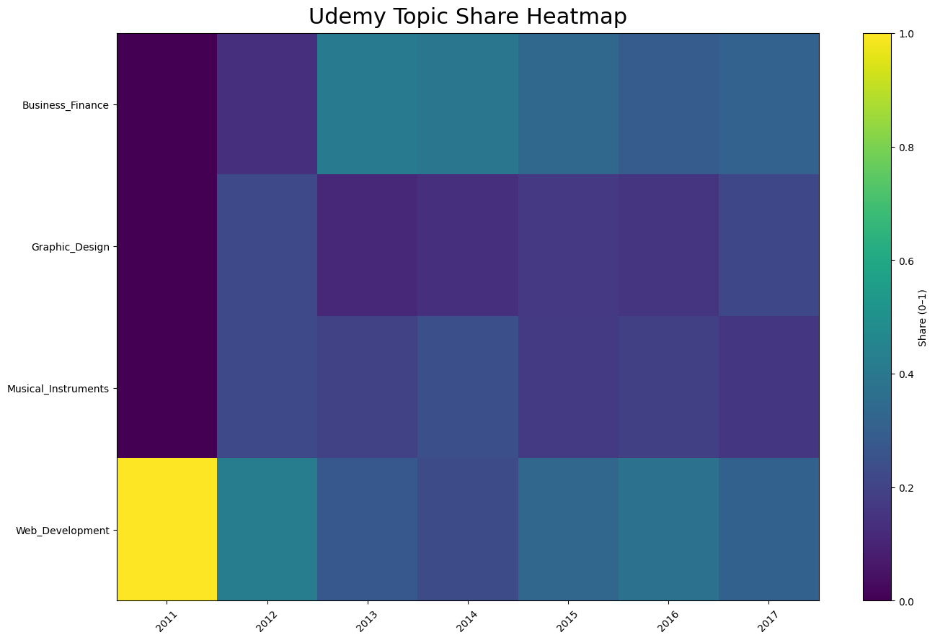
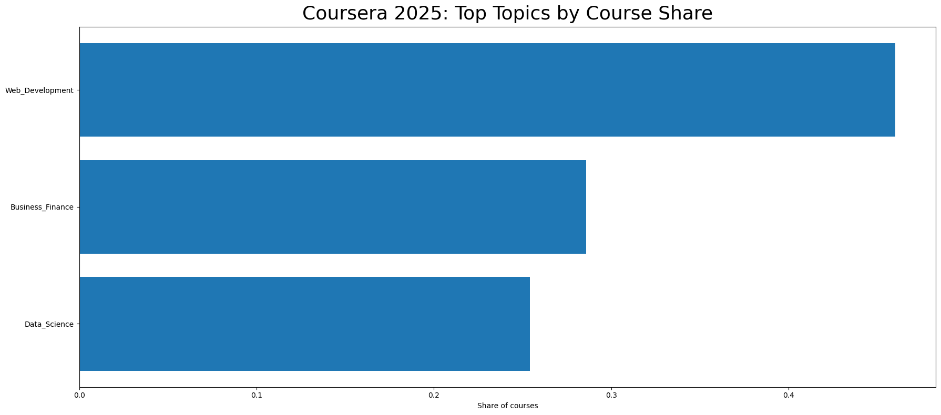
Key Visuals
Udemy Trends: Business_Finance & Web_Development grew consistently, while Graphic_Design & Music fluctuated slightly
Coursera Snapshot (2025): Data_Science & Business_Finance dominate current catalog
Combined Trends: Aligns Udemy time series with Coursera snapshot for overlap analysis

Slide 6
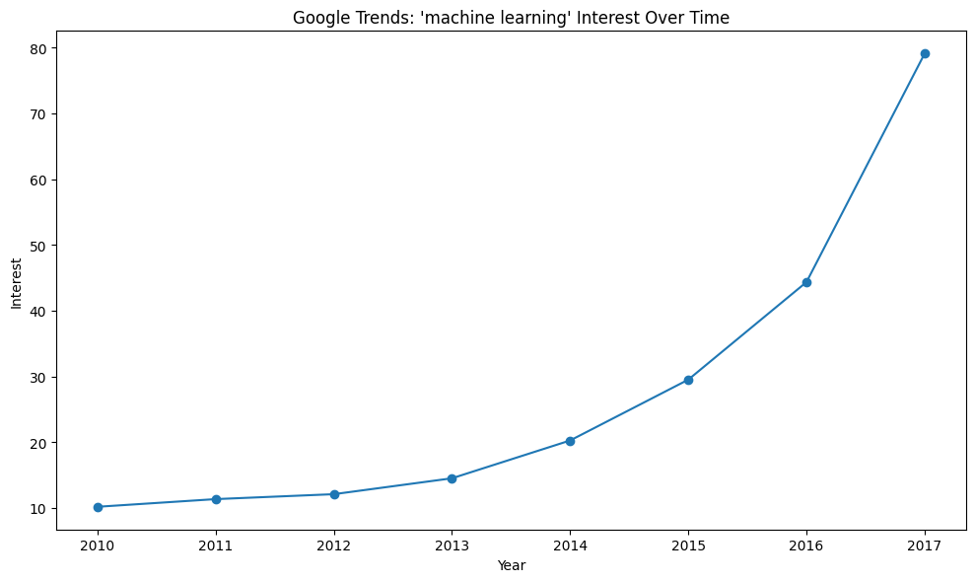
Google Trends Integration
Pulled from Google Trends using Pytrends API:
Keyword: “machine learning”
Time frame: 2010 - 2025
Aggregated from weekly to yearly interest averages
Outputs:
Trends_machine_learning_yearly.csv
Trends_machine_learning_preview.json
Visual: trends_machine_learning_line.png
Key observation: Internet spikes after 2017 and remains strong through 2025

Slide 7
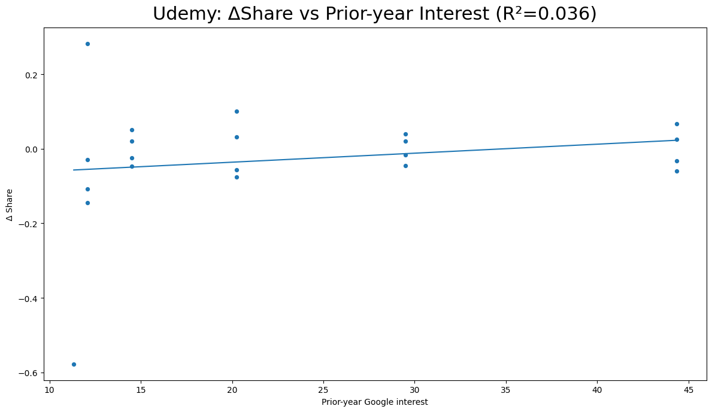
Regression Results
Model:
ΔShare(t) = β0 ​+ β1 ​× Interest(t−1)
R² = 0.0361 → 3.6% variance explained
Interpretation:
Google interest alone is a week predictor of Udemy topic growth
Suggests platform content expansion is influenced by multiple external factors
(Figure: udemy_delt_share vs_ interest.png)

Slide 8
Summary & Insights
Findings
Udemy: rapid growth in tech and business topics
Coursera: steady dominance in data and IT fields
Google Trends interest aligns with-but doesn’t directly drive course creation
Implications
Public curiosity mirrors educational trends
Useful for identifying emerging learning markets (e.g., AI, data science)

Slide 9
Next Steps & Acknowledgment
Future Improvements:
Acknowledgment:
Broaden API keywords: “AI”, “data analytics”, “web design”
Add enrollment or rating data for demand analysis
Include trend forecasting (ARIMA or Prophet)
Data sourced from Kaggle and Google Trends (Pytrends API)

Slide 10
Thanks!

